Slide 1
Series and parallel connection - Inductor

Slide 2
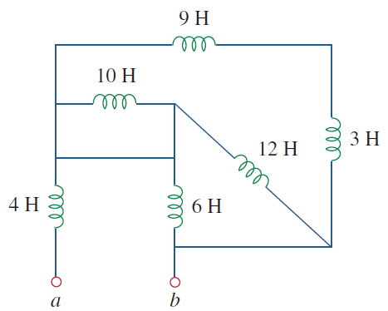
Determine the L_{eq} of the circuit

Slide 3
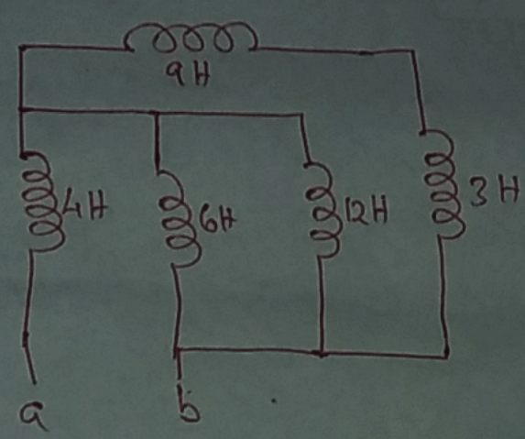
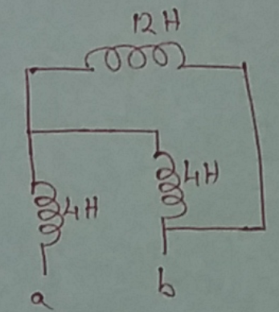
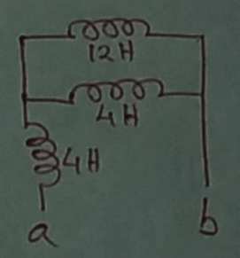


Slide 4
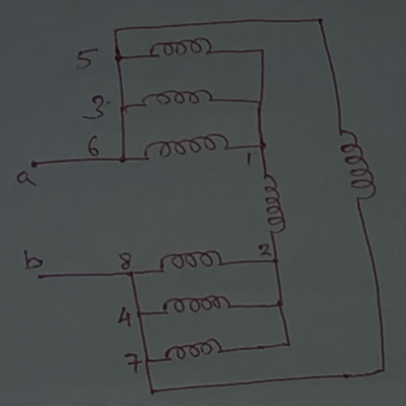
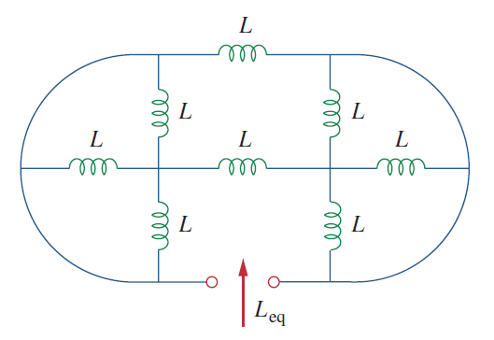
Determine the L_{eq} of the circuit, L = 1H

Slide 5
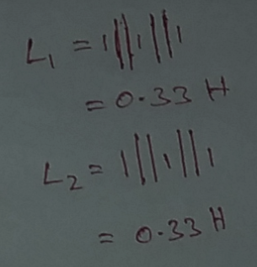

Slide 6
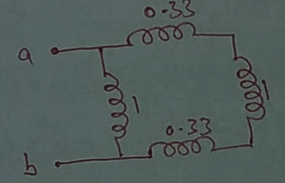
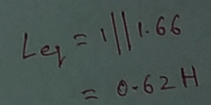

Slide 7
Reference
Edward Hughes. “Electrical and Electronic Technology”, 10th Edition, Pearson Education Asia, 2019
Alexander and Sadiku. “Fundamental of electric circuits”, McGraw-Hill, Fifth editon

Slide 8
Thank You

